Slide 1
The Importance of Early Childhood
Nutrition and Development
2024/11/15
Keynote speech
Notes:
We're happy about the opportunity to introduce WHH’s strategic and community-led approach in ending malnutrition today.
Most likely, there are not that many international NGOs worldwide that have such a strong track record in holistic nutrition approaches as we do.
But strangely, we’re not that well-known outside of Germany. That’s something we want to change because we're keen on sharing what we think are good practices and forge strategic relationships with international stakeholders and philanthropies in the hope that they might be able to join forces for our signature program Nutrition Smart CommUNITY and beyond. Our goal here is to accelerate impact.

Slide 2
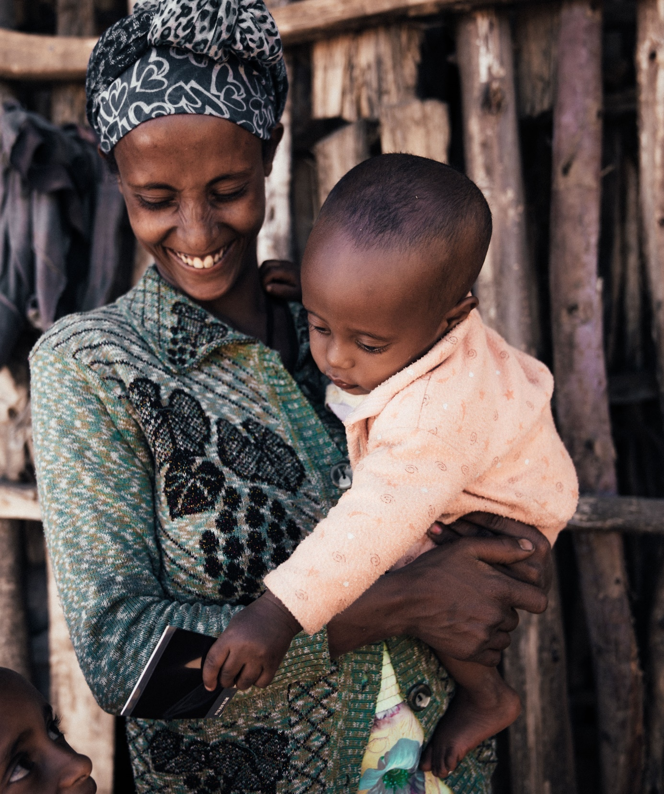

A quick primer on WHH
The largest German humanitarian NGO
A global thought & practice leader in multi-sectoral nutrition, food and WASH systems
Non-partisan, non-denominational, and backed by the German Presidency
3,678
352
284
16.4
36
Staff, 90% local
Million USD funding per year
Local partner organizations
Million people supported in 2023
countries supported through governance and/or markets work
Photo: Welthungerhilfe / Wiards

Slide 3
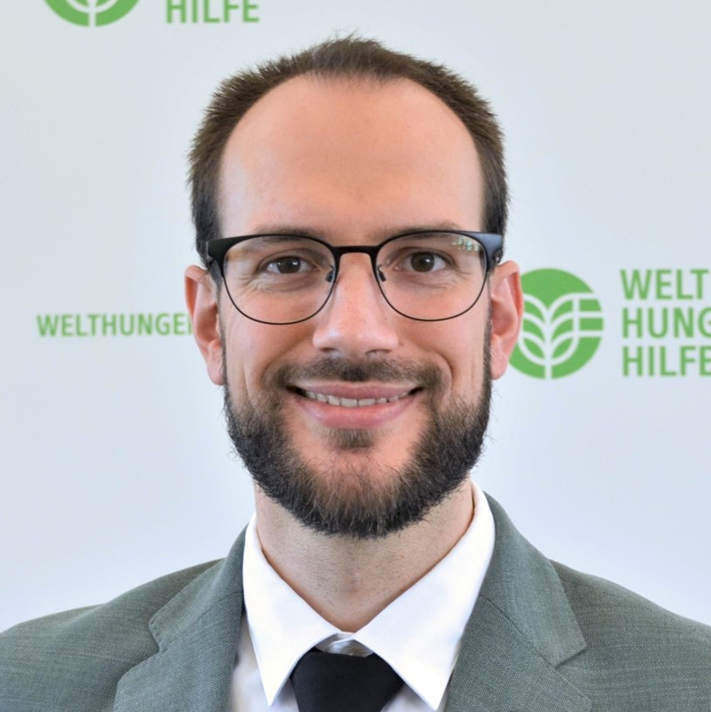
Arno Bratz
Head of Sector Strategy, Knowledge & Learning
Welthungerhilfe (WHH)

Slide 5
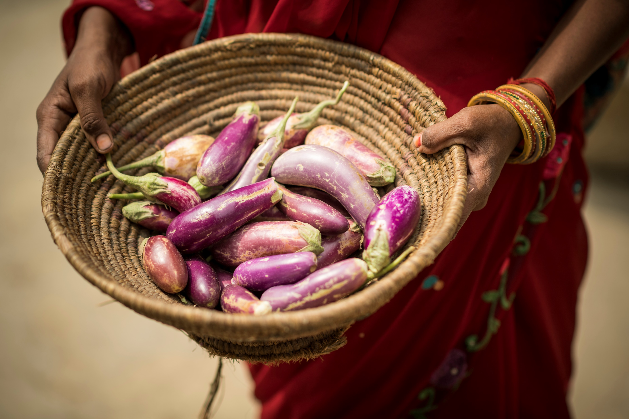

Globally:
149mm
Children under 5 are stunted
In South Africa:
28.8%
Of children are stunted
A stunted population leads to a stunted society and economy by slowing down growth and fueling inequality
Photo: Welthungerhilfe / Wiards

Slide 6
Zero Stunting is not only possible. It is also a business opportunity, a catalyst for socio-economic growth and: it is cheap.

Slide 7
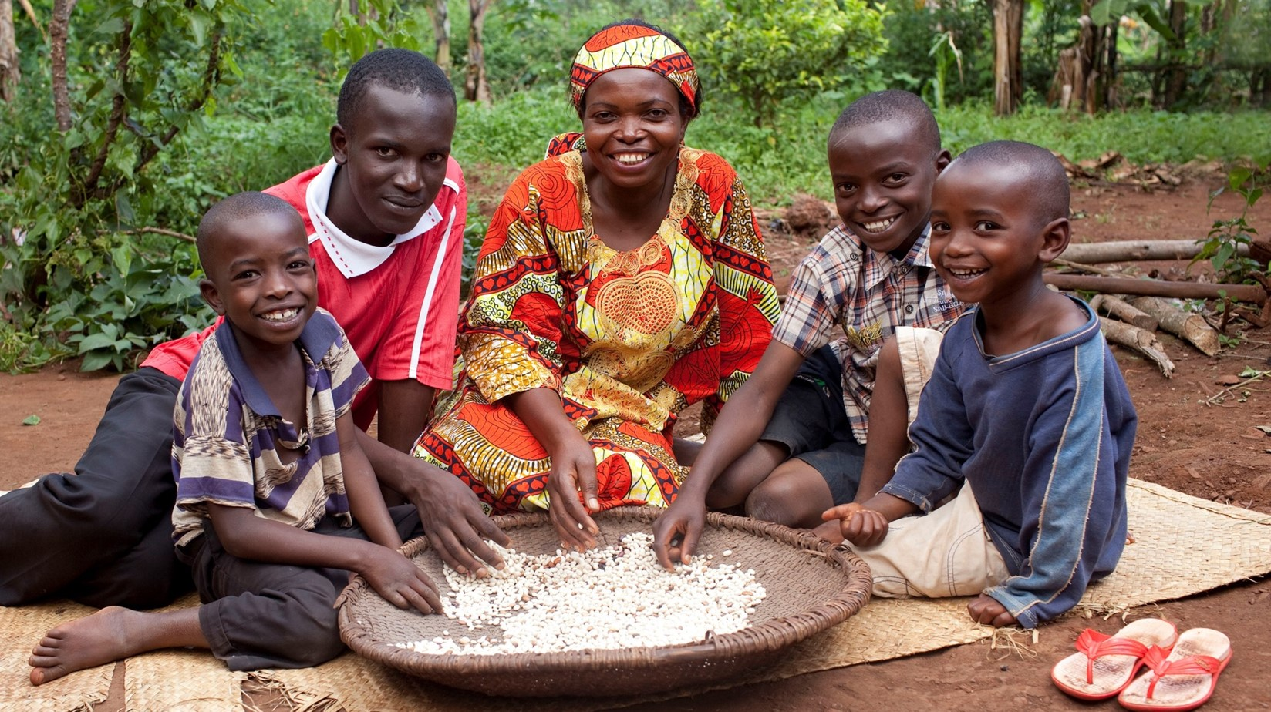
1. It is not about calories.
Notes:
In the following please introduce yourself in 2 sentences Gisela
To advance conversations with the Mastercard Foundation on a strategic upper organizational level we will need to develop a big picture and pot. high-impact concept note on how to reach 100,000s of youth.
WHH Innovation working on requested BMGF concept notes on CGM and digital literacy clinics.
Team in Burundi preparing school feeding fact sheet / cap statement for Rockefeller.
Communications is vital also for fundraising purposes. In 2024, the P&P team helped coordinate comms and social media efforts. We observed that many organizations timed the publication of major reports around the time of the conference.

Slide 8
2. It's not just about food either.
Notes:
In the following please introduce yourself in 2 sentences Gisela
To advance conversations with the Mastercard Foundation on a strategic upper organizational level we will need to develop a big picture and pot. high-impact concept note on how to reach 100,000s of youth.
WHH Innovation working on requested BMGF concept notes on CGM and digital literacy clinics.
Team in Burundi preparing school feeding fact sheet / cap statement for Rockefeller.
Communications is vital also for fundraising purposes. In 2024, the P&P team helped coordinate comms and social media efforts. We observed that many organizations timed the publication of major reports around the time of the conference.

Slide 9
3. Zero Stunting is possible.
Notes:
In the following please introduce yourself in 2 sentences Gisela
To advance conversations with the Mastercard Foundation on a strategic upper organizational level we will need to develop a big picture and pot. high-impact concept note on how to reach 100,000s of youth.
WHH Innovation working on requested BMGF concept notes on CGM and digital literacy clinics.
Team in Burundi preparing school feeding fact sheet / cap statement for Rockefeller.
Communications is vital also for fundraising purposes. In 2024, the P&P team helped coordinate comms and social media efforts. We observed that many organizations timed the publication of major reports around the time of the conference.

Slide 10
4. Zero Stunting is a business opportunity.
Notes:
In the following please introduce yourself in 2 sentences Gisela
To advance conversations with the Mastercard Foundation on a strategic upper organizational level we will need to develop a big picture and pot. high-impact concept note on how to reach 100,000s of youth.
WHH Innovation working on requested BMGF concept notes on CGM and digital literacy clinics.
Team in Burundi preparing school feeding fact sheet / cap statement for Rockefeller.
Communications is vital also for fundraising purposes. In 2024, the P&P team helped coordinate comms and social media efforts. We observed that many organizations timed the publication of major reports around the time of the conference.

Slide 11
5. Zero Stunting can only be achieved together.
Notes:
In the following please introduce yourself in 2 sentences Gisela
To advance conversations with the Mastercard Foundation on a strategic upper organizational level we will need to develop a big picture and pot. high-impact concept note on how to reach 100,000s of youth.
WHH Innovation working on requested BMGF concept notes on CGM and digital literacy clinics.
Team in Burundi preparing school feeding fact sheet / cap statement for Rockefeller.
Communications is vital also for fundraising purposes. In 2024, the P&P team helped coordinate comms and social media efforts. We observed that many organizations timed the publication of major reports around the time of the conference.

Slide 12
6. Zero Stunting is a catalyst for socioeconomic growth.
Notes:
In the following please introduce yourself in 2 sentences Gisela
To advance conversations with the Mastercard Foundation on a strategic upper organizational level we will need to develop a big picture and pot. high-impact concept note on how to reach 100,000s of youth.
WHH Innovation working on requested BMGF concept notes on CGM and digital literacy clinics.
Team in Burundi preparing school feeding fact sheet / cap statement for Rockefeller.
Communications is vital also for fundraising purposes. In 2024, the P&P team helped coordinate comms and social media efforts. We observed that many organizations timed the publication of major reports around the time of the conference.

Slide 13
7. Zero stunting is cheap.
Notes:
In the following please introduce yourself in 2 sentences Gisela
To advance conversations with the Mastercard Foundation on a strategic upper organizational level we will need to develop a big picture and pot. high-impact concept note on how to reach 100,000s of youth.
WHH Innovation working on requested BMGF concept notes on CGM and digital literacy clinics.
Team in Burundi preparing school feeding fact sheet / cap statement for Rockefeller.
Communications is vital also for fundraising purposes. In 2024, the P&P team helped coordinate comms and social media efforts. We observed that many organizations timed the publication of major reports around the time of the conference.

Slide 14
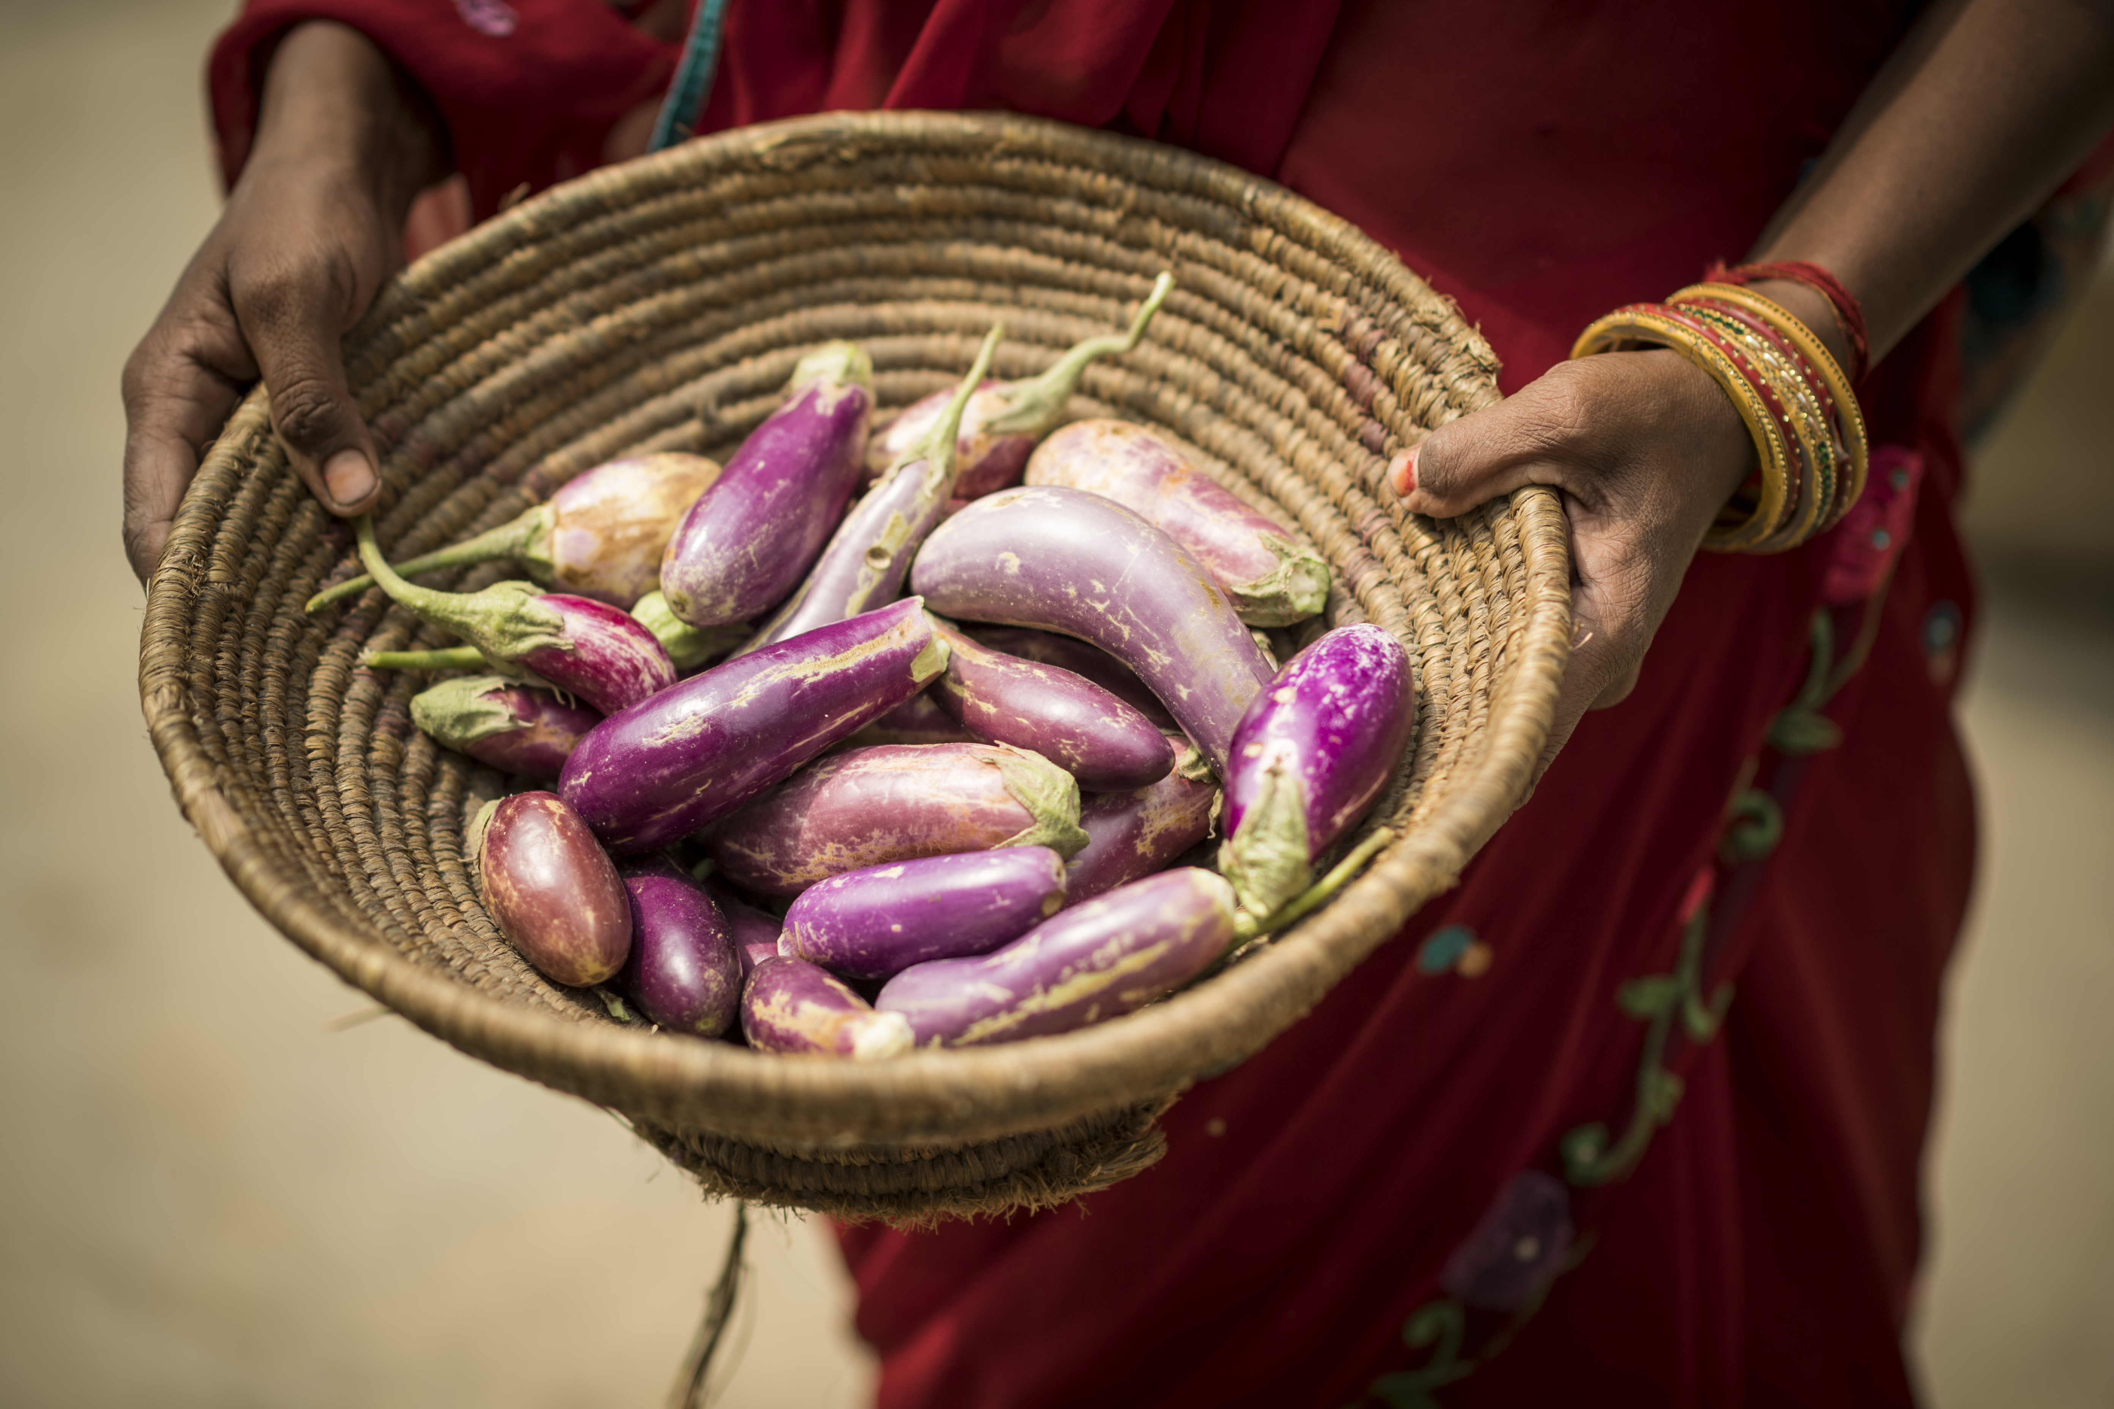
Zero Stunting is not only possible. It is also a business opportunity, a catalyst for socio-economic growth and: it is cheap.

Slide 15
Let’s end stunting, together.
Arno Bratz
Head of Sector Strategy, Knowledge & Learning
arno.bratz@whh.de

