Slide 1

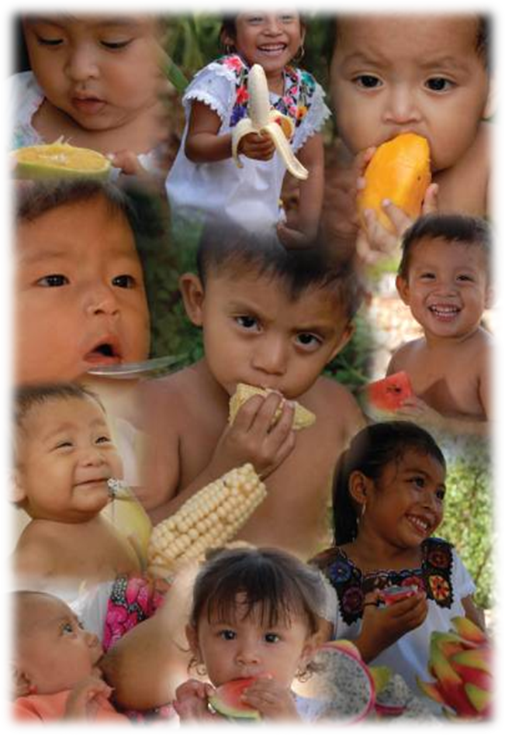
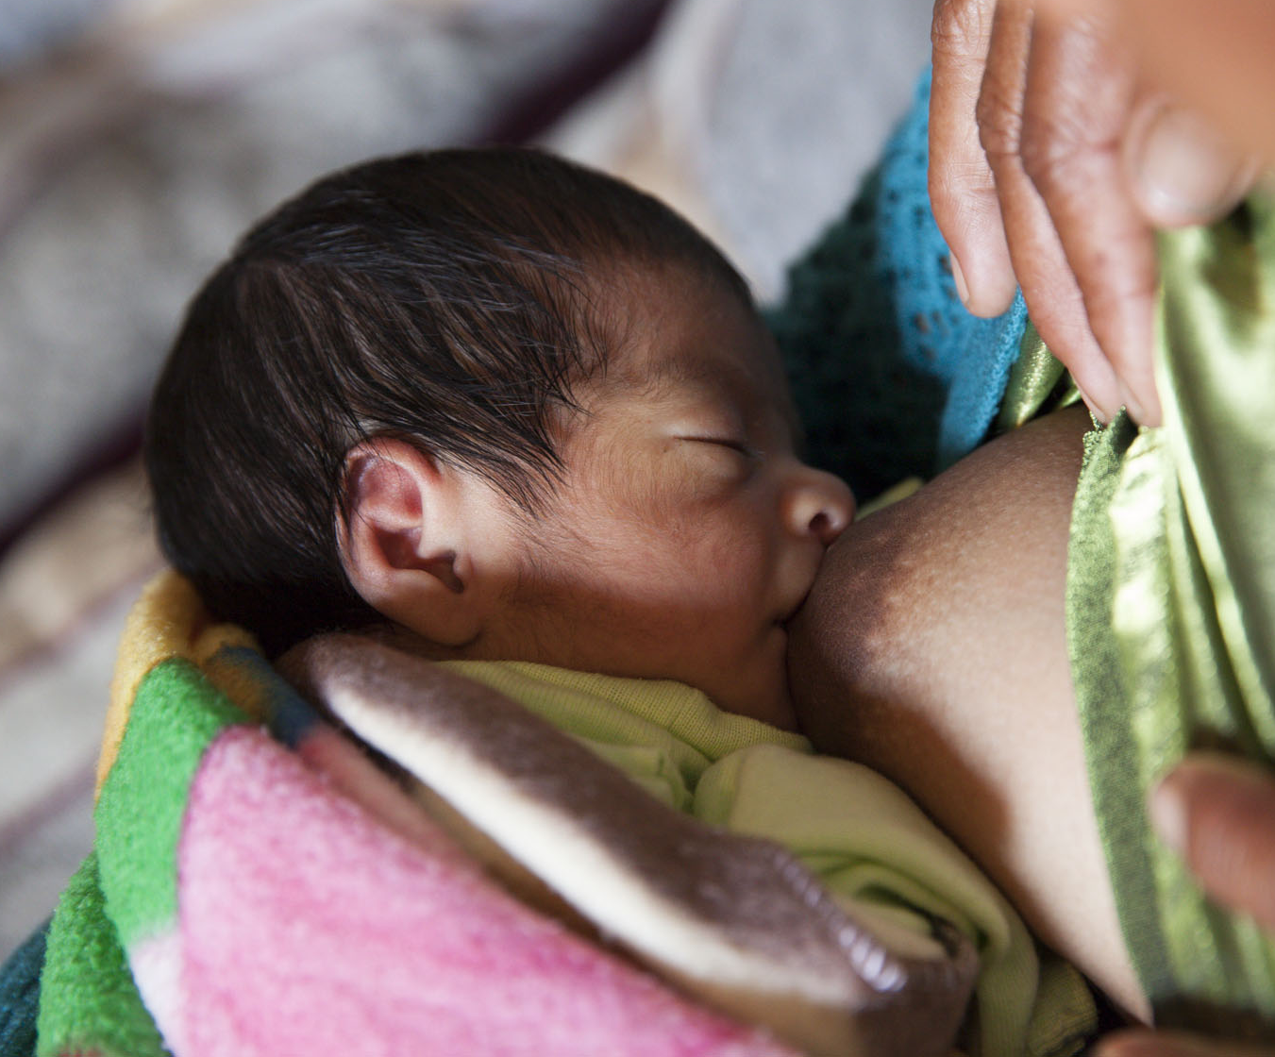
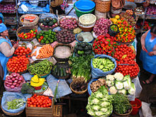
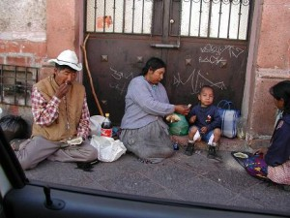
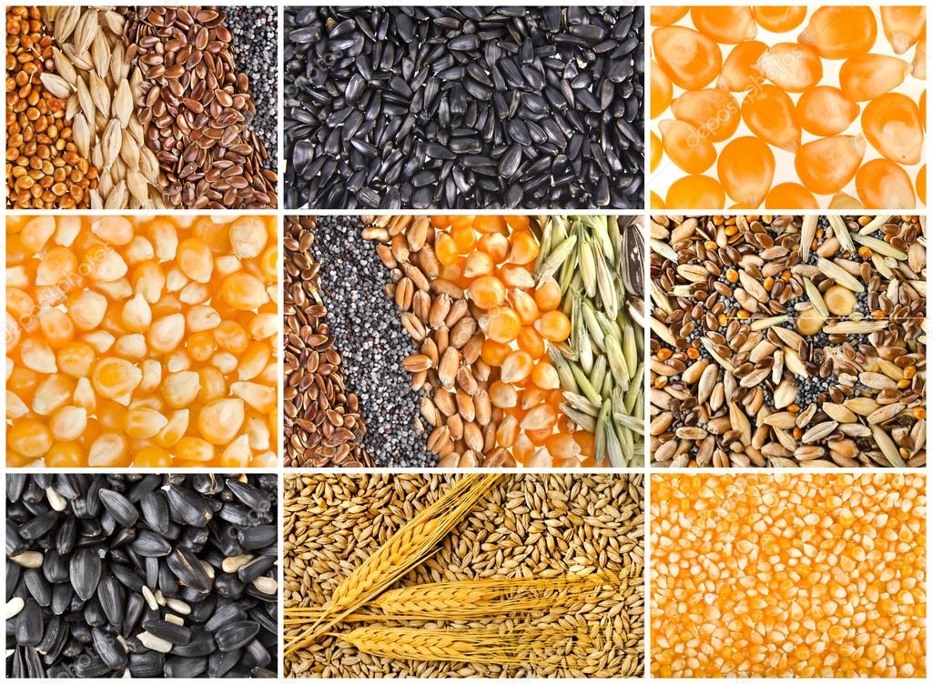
Beating Stunting: Case studies from developing country counterparts
Public Politicies in Mexico to reduce
Stunting
Dra. Teresa Shamah Levy
Deputy Director of the
Centre of Research of Evaluation and Surveys
National Public Health Institute
October, 18 2019
tshamah@insp.mx

Slide 2
About today´s session
Nutrition status in Mexico
PROSPERA
  EsIAN
Current Public Policies By the New Mexican Government
2019-2024

Slide 3
Before beginning………….
I do not have any interest conflicts

Slide 4
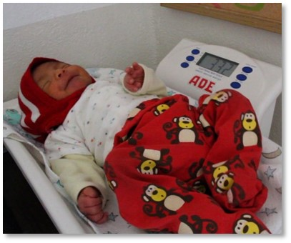
Evolution of Nutrition status of children <5 y in Mexico

Slide 5
National Prevalences of malnutrition in children <5 years old from1988-2016. Results from the National Health and Nutrition Surveys
%
2016

Slide 6
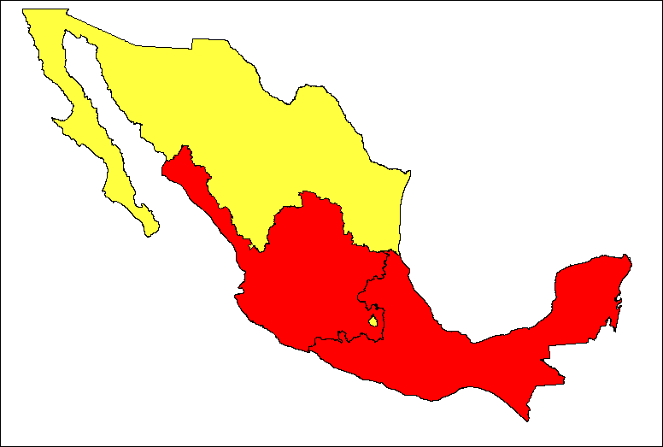
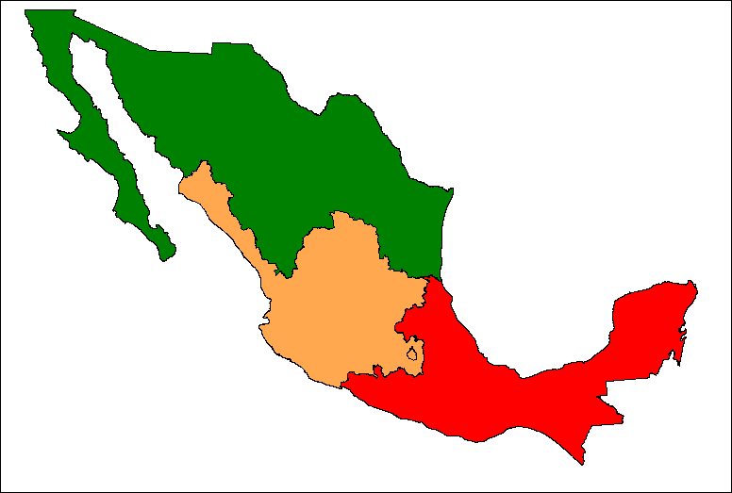
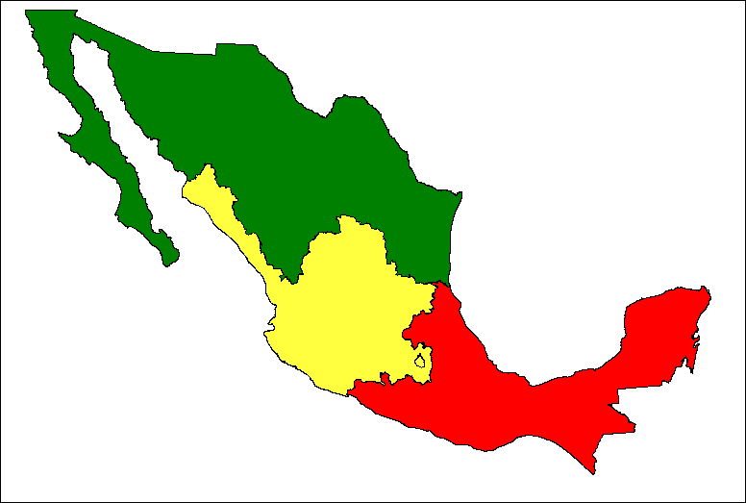
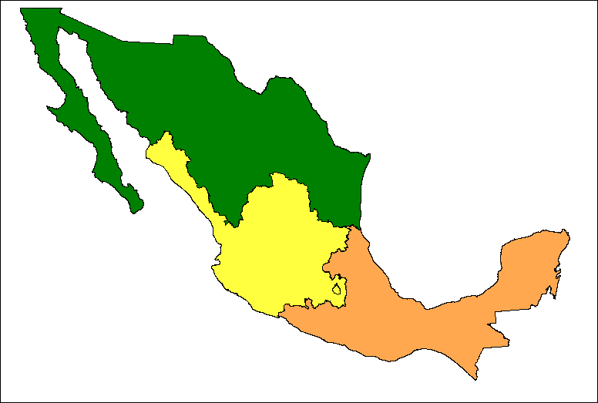
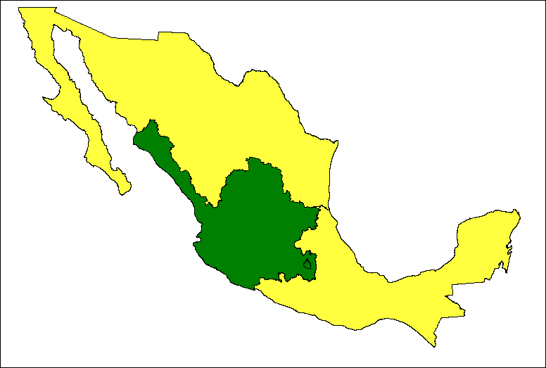
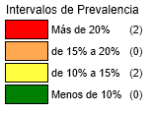
National prevalence of low height for age in children <5 y (1988-2016)
1988
1999
2006
2012
2016
Categories of Prevalence
More than 20% (2)
From 15% to 20% (0)
From 10% to 15% (2)
Less than 10% (0)

Slide 7
National Prevalences of malnutrition in children <5 years old, 2016.
Results from the National Health and Nutrition Surveys in Mexico-South Africa
2016
Source: South African Demographic Survey (SADHS), 2016

Slide 8
Drop of the NATIONAL prevalence of EBF
5.6 pp
Prevalence
National
Indigenous
Not indigenous
Low HWI
High HWI
Maternal
education 1-<Y
Maternal
Education >14Y
González de Cossío T et al.
SPM. 2013;55 suppl 2:S170-S179.
HWI: Household Wealth Index

Slide 9
National Prevalences of overweight and obesity by age and sex groups
Overweight
Obesity
Female
School-age girls (5-11 years)
Female adolescents (12-19 years)
Women adults (20-49 años)
Overweight
Obesity
Male
School-age boys (5-11 years)
Men adolescents (12-19 years)
Men adults (20-49 years)
Source: ENN 88 y 99, ENSANUT 2006 Y 2012, ENSANUT Medio Camino (half -way) 2016
* Classification system proposed by WHO

Slide 10
National Prevalences of overweight by sex and age groups in Mexico- South Africa 2016
2016
Source: ENSANUT Medio Camino, 2016 /South African Demographic Survey (SADHS), 2016
* Classification system proposed by WHO

Slide 11
SOCIAL POLICY DEVELOPMENT
Integral Actions
(General Population)
Education
Social Protection
Job training
Focused Actions (Population in Poverty)
Human Capital Development
Education
Health
Health
Housing
Feeding
Income opportunities
Focused Actions (Population in Poverty)
Financial, Productive and Labor market inclusion
Safe water, sanitation, rural highways, communications and housing
PROGRESA 1997
OPORTUNIDADES 2006
PROSPERA
2013
PROSPERA-2014
Modificado de: 1575-DS ASF“EVALUACIÓN DE LA POLÍTICA PÚBLICA DE PROSPERA PROGRAMA DE INCLUSIÓN SOCIAL”, p23.

Slide 12
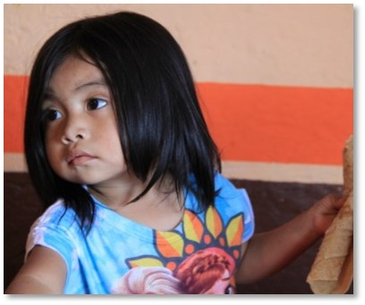
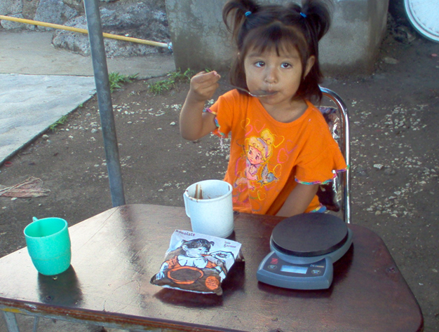
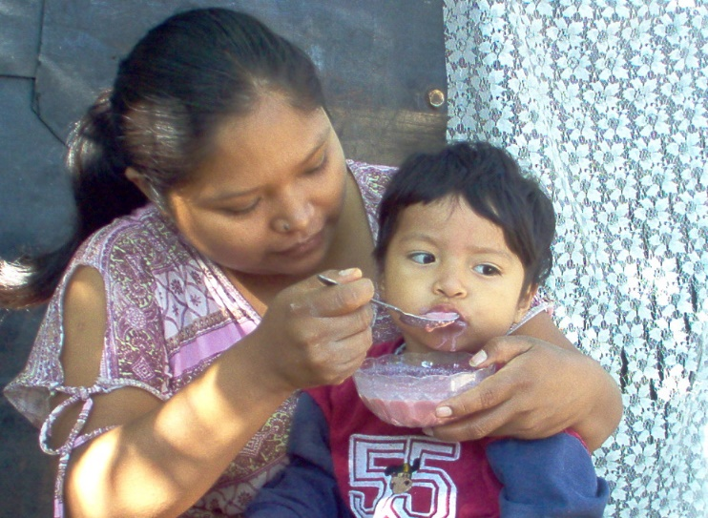
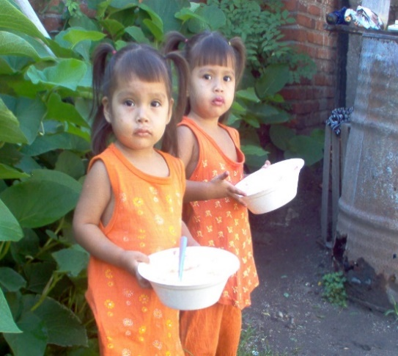
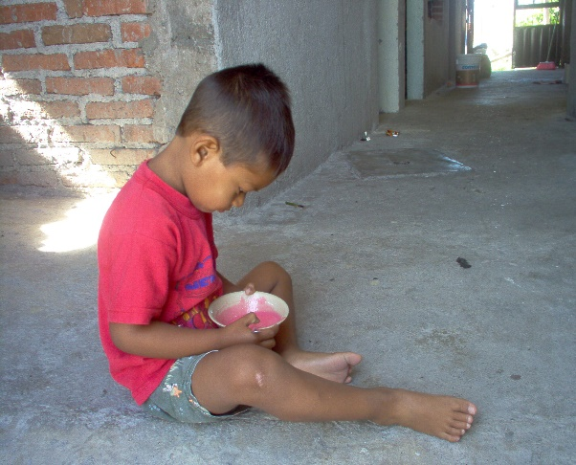
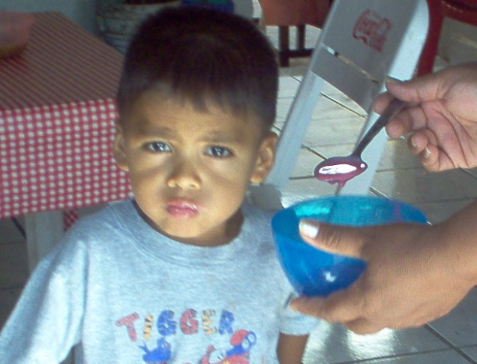
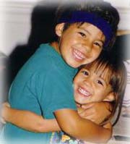
PROSPERA – Inclusion Program

Slide 13
Prospera (1997-2018)
A conditional cash transfer program to improve public service utilization.
Mexican Social Development, Health and Education Ministries.
Covers over 6.1 million families and 26 million people.
Notes:
A national strategy to strengthen the health and nutritional component of Prospera to address the nutritional transition in Mexico and improve the health and nutrition of beneficiaries.
SBCC is an interactive, researched and planned process.
Strategies of proven efficacy and effectiveness
Focus on the 1,000 days
To address double burden of malnutrition with a life cycle approach
Evidence based: external evaluation and efficacy studies in the context of the program.
An integrated MIYCN strategy that includes MNPs.

Slide 14
Prospera Program Scheme: Lactation and Pregnant Women.
Co-responsibilities
Cash transfer
Suplementation
Women
Pregnant women and in Lactation period: 30 USD/month
Antenatal care
Once a month at Medical Units
Pregnant women
Attend workshops on different thematics: antenatal care; familar plannification; papanicolao, weight gain
Lactation Period throughout 2 years

Slide 15
Prospera ProgramScheme: Mothers/Children
Co-responsibilities
Cash transfer
Suplementation
Mothers
Children <5 years, 30 USD/month
Nutrition monitoring
Once a month at Medical Units
All children < 2y and undernourished children from 2 to 5 y
Attend workshops on different thematics: EBF; complementary feeding; supplementation

Slide 16

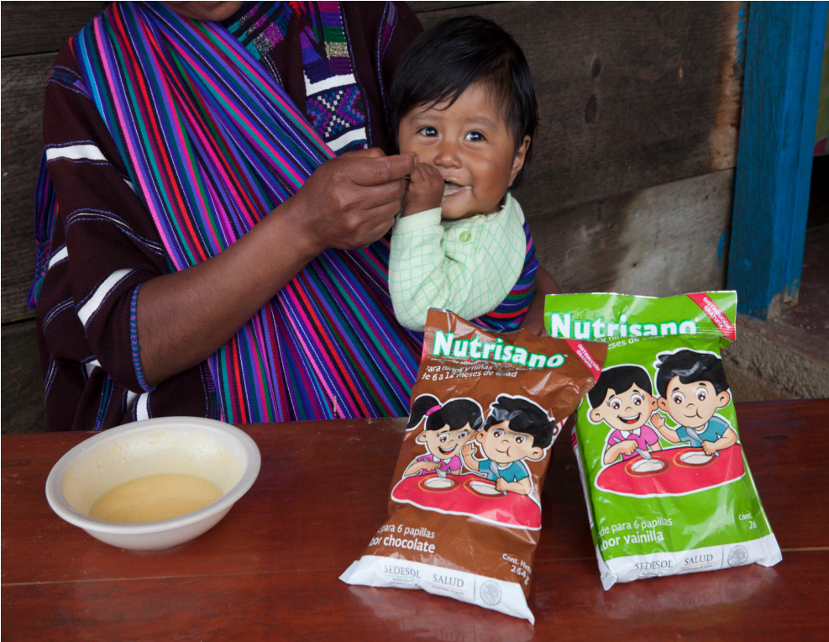


National Integrated Nutritional Strategy
Integral Strategy for Nutrition Attention

Slide 17
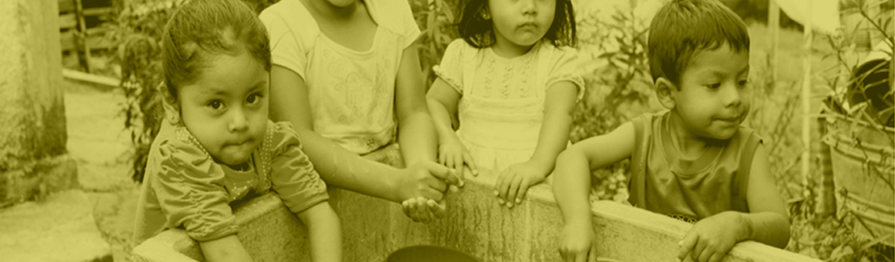
What is
?
A national strategy to strengthen the health and nutritional component of Prospera to address the nutritional transition in Mexico and to improve the health and nutrition of beneficiaries.

Slide 18
EsIAN:
Strategies of proven efficacy and effectiveness
Focused on the 1,000 days
To address both under nutrition and obesity with a life cycle approach
Evidence based on external evaluation and efficacy studies in the context of the program
Systematic process
Systematic thinking

Slide 19

An integrated MIYCN strategy
Pregnancy
0-6 m
7-23 m
24-59 m
Promotion of healthy eating and physical activity.
Appropriate weight gain.
Anemia prevention (Tablets).
Promotion of breastfeeding.
Exclusive breastfeeding.
Nutrition assessment.
Complementary feeding practices.
Nutrition assessment.
Use of MNP and other supplements.
Healthy eating and physical activity.
Nutrition assessment.
Use of MNP.

Slide 20

Health Units
Equipment
COMPONENTS
Behavior change communication and training
(BCC)
Supplementation
(MNP)
*BCC strategy based on Social Marketing

Slide 21




Suplementation
Pregnancy and lactation
6-11 m
12-23 m
24-59 m
Urban
Rural
+
+

Slide 22
BCC uses mutual Reinforcing :
Activities, channels and materials at many levels.
BCC materials distributed to 14,886 health clinics
94, 877 health workers trained (Dec 2018)
Physicians
26,146
Nurses
36,594
Health promotors
10,709
CHWs
(Community Health workers)
22,922
Notes:
Pilot test messages and material with target audience
The BCC component after pilot tested was reformulated to better provide answer to the needs of health providers, community volunteers and target populations.

Slide 23
Task definition - EsIAN
Physicians
Nurses
Health promotors
CHVs
Healthy pregnancy workshop.
Household visits to reinforce key messages:
Antenatal care
Supplement distribution
Complementary feeding workshop (use of supplement)
Use of supplement during pregnancy.
EBF.
Supplements.
Complementary feeding 6-24 m.
Growth monitoring
Simplified counseling: key messages.
Breastfeeding workshop.
Growth monitoring
Key messages
Well child visit

Slide 24
Support Material - EsIAN
Physicians
Nurses
Health promotors
CHWs
Healthy pregnancy flipchart.
Household visits material:
Desktop flipchart.
Breastfeeding flipchart.
Health Clinic Manual.
Health Clinic Manual.
Complementary feeding flipchart.
Health promotor manual.
Supplements.
Healthy pregnancy.
EBF.
Supplements.
Supplements.
Complementary feeding 6-24 m.

Slide 25

Online Training

Slide 26
Low height prevalence in children < 5 years beneficiaries of PROSPERA program between 2012 and 2018.
20.7

Slide 27

At this time the program grants directly to the school-children a welfare schoolarship “BENITO JUAREZ”: 80 USD/bimonthly
PROSPERA IS A SCHOOLARSHIP PROGRAM AIMED AT PRESCHOOL, ELEMETARY AND JUNIOR-HIGH STUDENTS

Slide 28

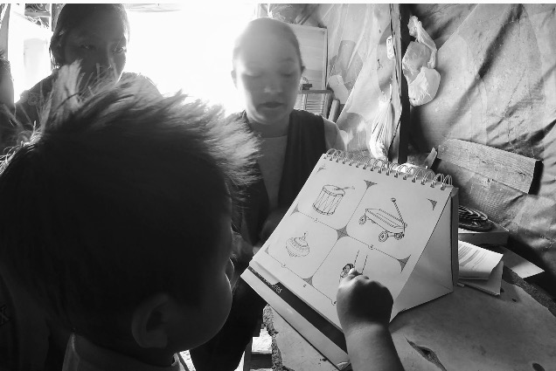
Current Public Policies
By the New Government
2019-2024

Slide 29
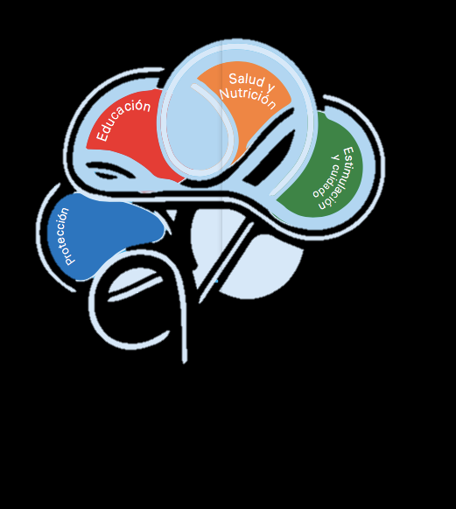
EARLY
CHILDHOOD
HEALTH
NUTRITION
LEARNING OPPORTUNITIES
SAFE AND PROTECTION

Slide 30
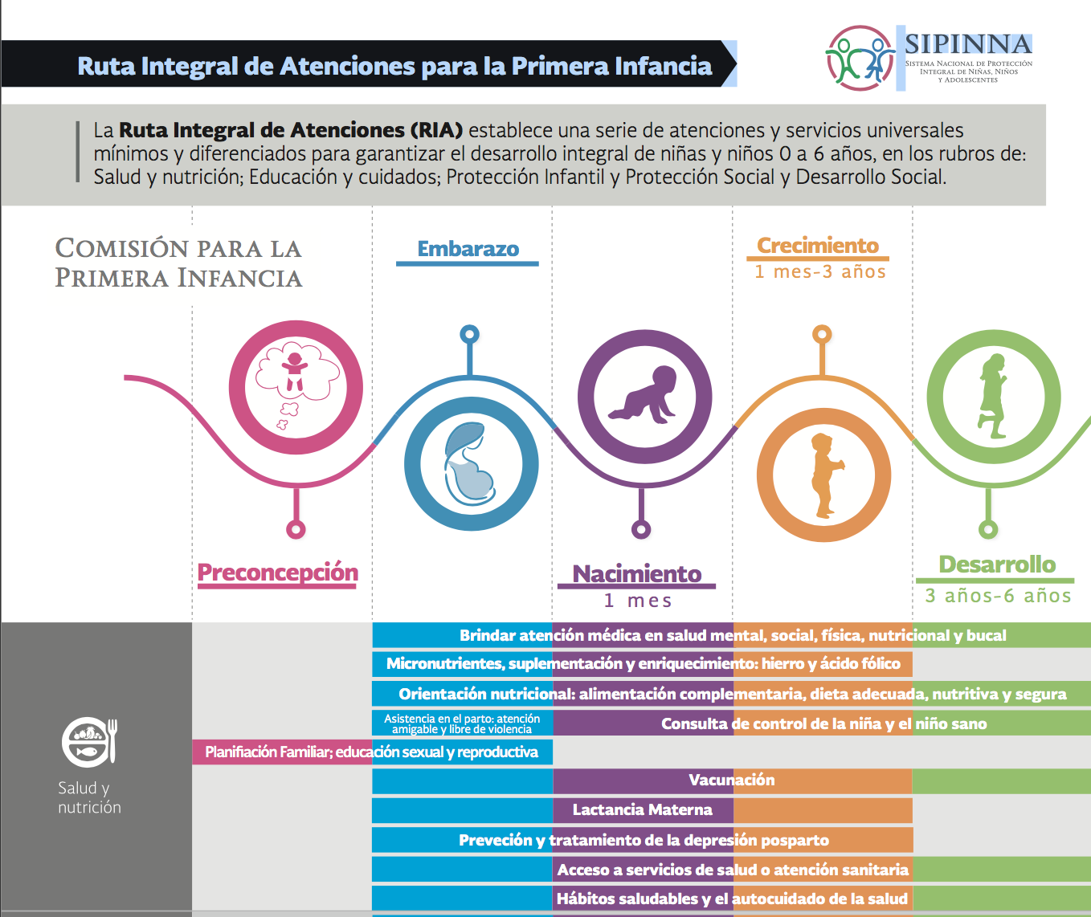

Slide 31

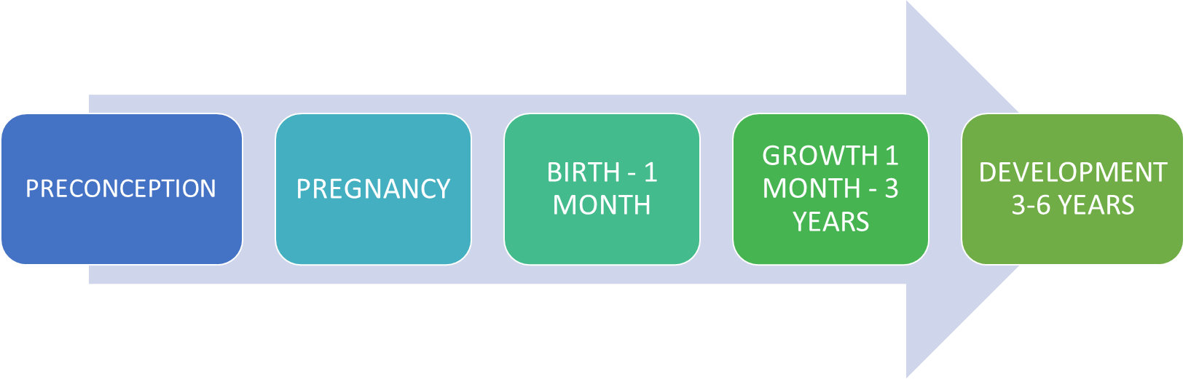

INTEGRAL ROUTE FOR THE ATTENTION OF FIRST CHILDHOOD
THE ROUTE OF CARE ESTABLISHES A SERIES OF MINIMUM ACTIONS AND DIFFERENTIATED SERVICES FOR THE INTEGRAL DEVELOPMENT OF GIRLS AND BOYS FROM 0 TO 6 YEARS OF AGE, IN HEALTH AND NUTRITION; EDUCATION AND CARE; SOCIAL PROTECTION, CHILDREN PROTECTION AND SOCIAL DEVELOPMENT
COMMISSION FOR FIRST CHILDHOOD
HEALTH AND NUTRITION

Slide 32
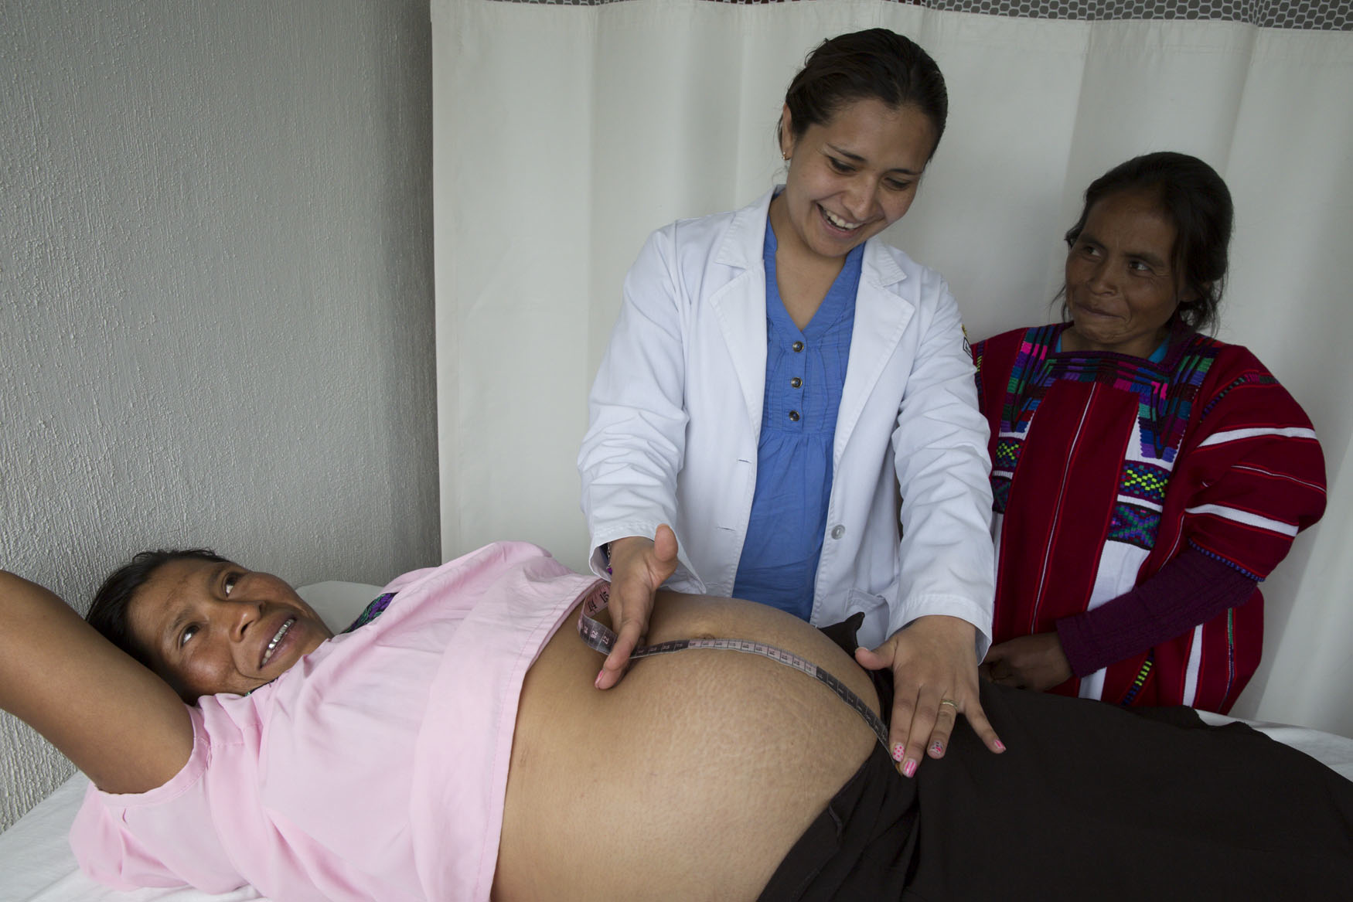
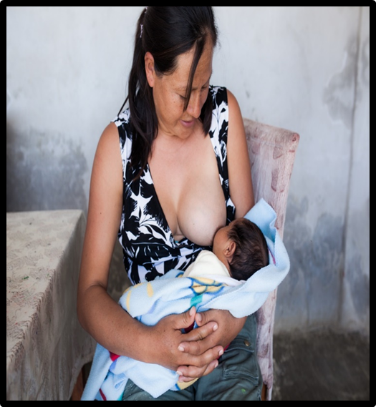
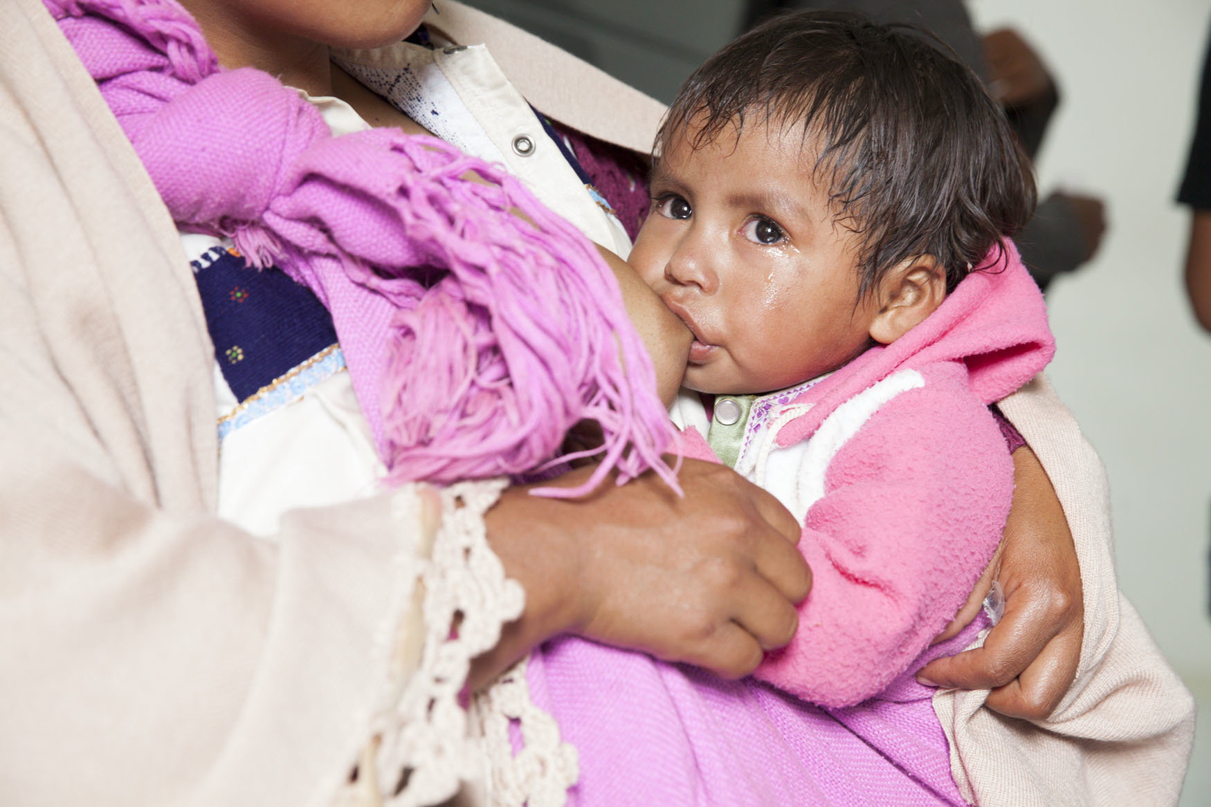
Dr. Teresa Shamah Levy
CIEE-INSP
tshamah@insp.mx
Thank you!

